Slide 1

BUS7C1 CORPORATE STRATEGY AND INTERNATIONAL MANAGEMENT
Lecture 3 -

Slide 2

Learning outcomes
Identify organisational resources and capabilities and how these relate to the strategies of organisations.
Analyse how resources and capabilities might provide sustainable competitive advantage on the basis of their Value, Rarity, Inimitability and Organisational support (VRIO).

Slide 3
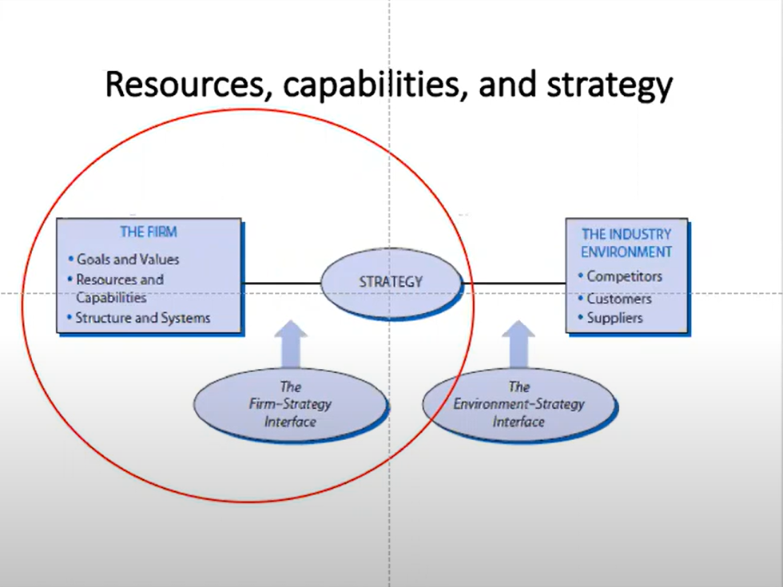

Slide 4
Foundations of resources and capabilities
The resources and capabilities of an organisation contribute to its long-term survival and potentially to competitive advantage.
Resources are the assets that organisations have or can call upon (e.g. from partners or suppliers), that is ‘what we have’ (nouns).
Capabilities (sometimes referred to as competences) are the ways those assets are used or deployed, that is ‘what we do’ (verbs).

Slide 5
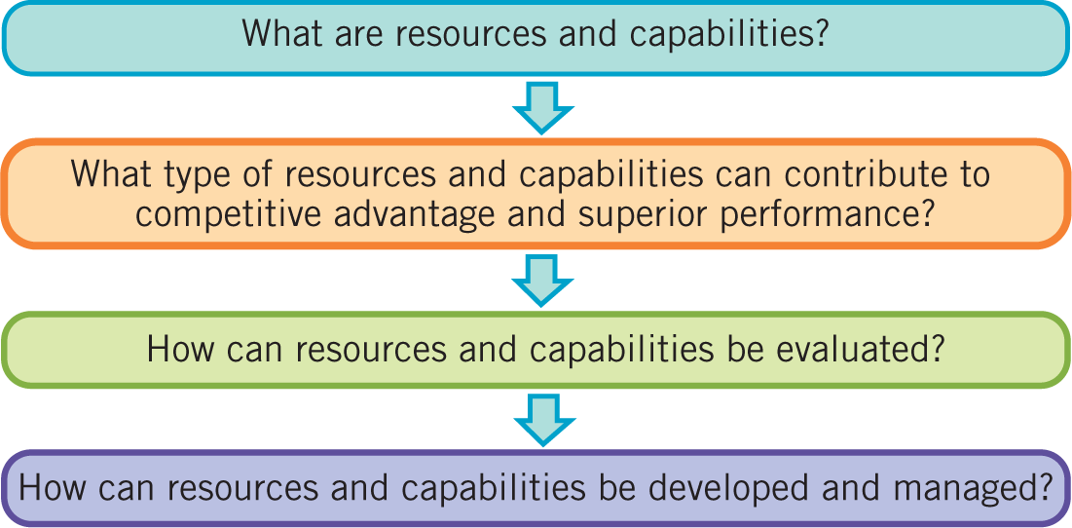
Resources and capabilities: the key issues

Slide 6
Primary source of superior returns
Industry Attractiveness
Monopoly rents
Competitive Advantage
Ricardian rents: Economic or Ricardian rents are ordinarily thought of as accruing to owners of unique factors. A firm could, for example, earn Ricardian rents if it is owned and operated by a good manager,3 if it owns attractively located land, or if it holds a patent.
Resource yield: Oil, Timber, weather…etc.

Slide 7
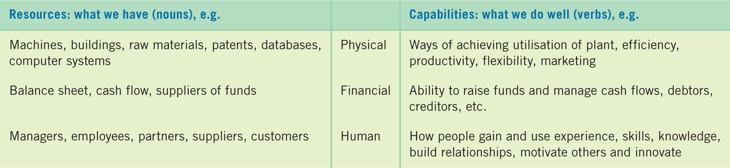
Resources and capabilities and competitive Advantage
Hard to evaluate but defiantly used to create competitive advantage
You can see the value
Untaggable Resources
Patent, Trade secret, Reputation,
Brand History of relationship People are happy to work for some companies for sustainable competitive advantage.

Slide 8
task
Wrexham University
What are the resources and capabilities of WGU? Discuss with the person next to you

Slide 9
From Resources to competencies
Resources
What the firm's own or control
Control: strategic alliance, Join venture.. Etc
Capabilities
What the firm can do with resource it owns or controls
Dynamic capabilities
Capabilities that allow the modification/ adaptation/ creation of new capabilities and routines
e.g.: learning to address changes in business environment.
Core competencies
Distinct capabilities that endow the firm with a competitive advantage
e.g. Functional, human reserouces,
Important to maintain them.
Core rigidities
Competence that have lost their ability to generate competitive advantage and which the firm cannot de couple due management myopia or path dependency.
E.g. Steam Engines

Slide 10
Redundant capabilities
Capabilities, however effective in the past, can become less relevant as industries evolve and change.
Such ‘capabilities’ can become ‘rigidities’ that inhibit change and become a weakness.

Slide 11
Task
Wrexham University
What might the redundant capabilities of WU be?
Discuss with the person next to you

Slide 12
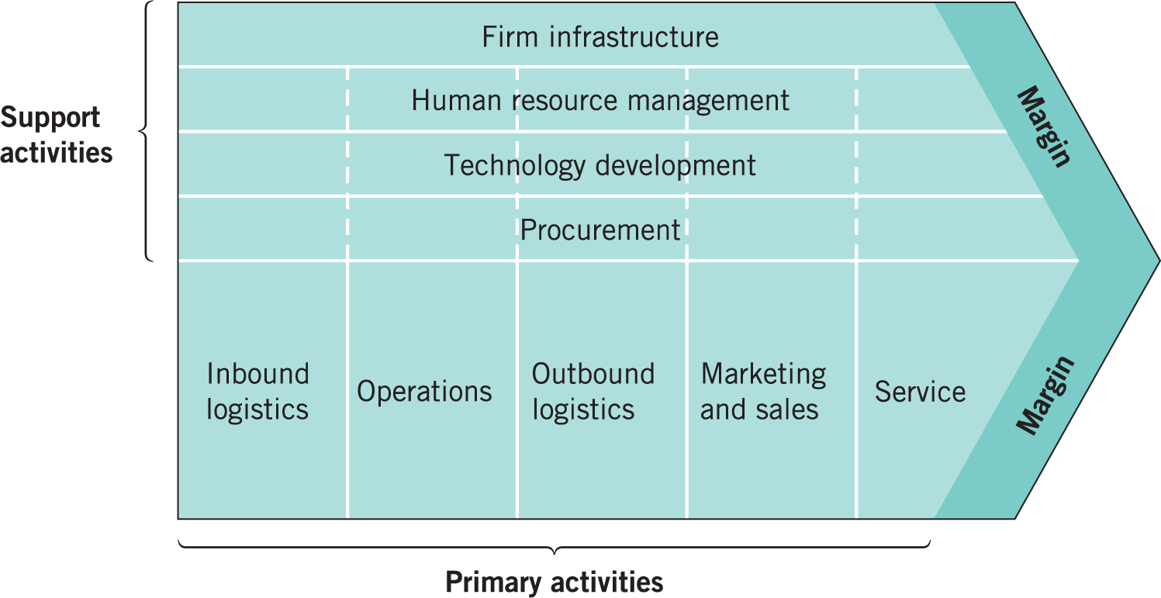
The value chain

Slide 13
Technology Development
Innovation: Open innovation and avoiding commodity trap
Manufacturing and business process knowledge are widely
distributed.
- Hard to differentiate products and sustain the differentiation.
Manufacturing is moving to global
-In the areas with very low cost, lots could be done in high quality.
-Pressure to produce and sell on the basis of cost, not value.
Shrinking product life cycle
- Product become obsolete quickly, putting a lot of new pressure to innovate

Slide 14
Revenue
Economically Attractive
Close Model
Past
Close Model
Present
Open Model
Future
New Business
Spin-Offs
New Revenues
Royalties
Revenue
Revenue
Revenue
Internal development cost
Internal development cost
Internal development cost
Notes:
So what happened under the old close innovation model is the revenue started to shrink, and this is because of the previously stated reason “ the commodity trap”.
At the same time the internal development cost starts to increase. Leaving the companies in a very vulnerable situation or making the business unattractive . We have know some companies have disappeared such as Kodak.
Nevertheless under the open Model where companies develop and collaborate or rely other or sell some innovation this might lead to another source of income or revenue. And make the business attractive again.

Slide 15
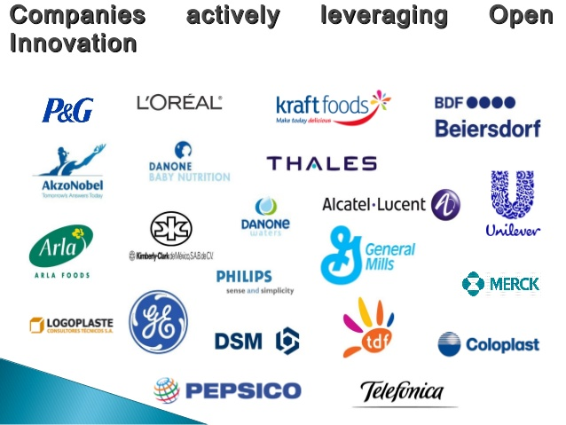
Open Innovation
OI is the use of purposive inflows and outflows of knowledge to accelerate internal innovation,
and expand the markets for external use of innovation (Chesbrough, 2003).
In the ‘closed’ innovation model, companies innovate relying on internal resources alone.
OI is characterised by the involvement of all company functions, at different stages of the
innovation process, not just R&D

Slide 16
THE PRINCIPLES OF OPEN INNOVATION
Based on Chesbrough’s (2003) book:
Not all smart people work in-house – need to tap into external knowledge
External R&D can generate significant value to us
Research does not need to originate from our internal work to be profitable for us
A strong business model is more important than first to market
Internal as well as external ideas are essential to win
We can capitalize on our own IP and we should buy others’ IP when needed

Slide 17
Resource-based strategy
The resource-based view (RBV) of strategy asserts that the competitive advantage and superior performance of an organisation are explained by the distinctiveness of its capabilities.
It is sometimes also called the ‘capabilities view’.

Slide 18
Strategic capabilities and competitive advantage
The four key criteria by which capabilities can be assessed in terms of providing a basis for achieving sustainable competitive advantage are:
value
rarity
inimitability and
organisational support
¹Jay Barney: ‘Firm resources and sustained competitive advantage’, Journal of Management, vol. 17, no. 1 (1991), pp. 99–120.

Slide 19
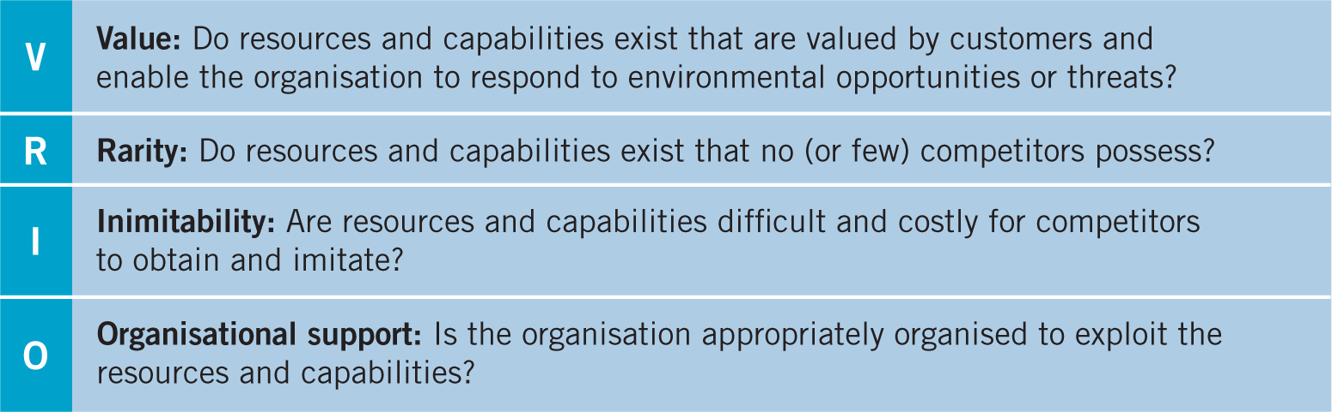
VRIO
https://www.youtube.com/watch?v=afrPC91zCkQ

Slide 20
Sustaining Competitive Advantage
Durability
Technology life cycle vs brand e.g. Apple, Disney
Transferability (non-tradebilty)
If a key resource may be easily acquired, it is unlikely to result in a sustainable advantage
Adverse selection problem
https://www.youtube.com/watch?v=2Zn9lYuD58c

Slide 21
Sustaining Competitive Advantage
Replicability ( non-imitability )
If a key resource/ capability may be easily imitated, it unlikely to result in a sustainable competitive advantage
Non –Substitutability
If a valuable/ rare resources/ capability may be easily substitute ,It is unlikely to result in sustainable competitive advantage.

Slide 22
Appropriating a competitive advantage
Property rights
Intellectual Property covers four main areas:
Strong industry effects: while some industries grand strong IP protection, other cannot suppress knock off.
E.g. Pharmaceutical industry
Relative bargaining power
Again, may be rotted in industry make –up – e.g. Fashion industry –Zara
Embeddedness
The extend to which key capabilities are rooted in the organizational rooted and cannot be decoupled.

Slide 23
Organisational knowledge
Organisational knowledge is organisation-specific, collective intelligence, accumulated through both formal systems and people’s shared experience.
‘Explicit’ knowledge or ‘objective’ knowledge is transmitted in formal systematic ways, e.g. systems manuals or market research.
‘Tacit’ knowledge is more personal, context-specific, hard to formalise and communicate and is difficult to imitate, e.g. the knowledge and relationships in a top R&D team.

Slide 24
Utilising the knowledge
Why Kodak Failed - Rise And Fall of Kodak
https://www.youtube.com/watch?v=j33EGRmol1Y&t=67s

Slide 25
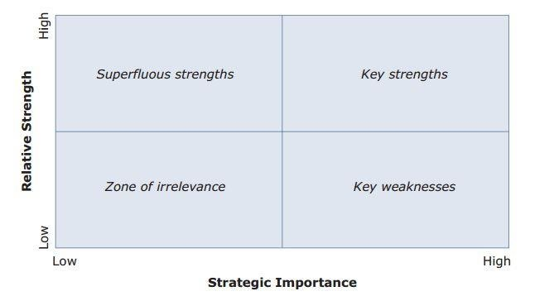
Making sense of resources and capabilities

Slide 26
Managing Capabilities
Deploy key strength to the greatest effect e.g. Disney using multiple channels, DVD, Streaming service.
Outsource key weakness
Divest superfluous strength
Divest or ignore inconsequential weakness ( zone of irrelevance)

Slide 27
Improper Management Capabilities
Typewriter vs. word processing;1960
Olivetti typewriter- like kodak going after the same customers.
Remington Typewriter – same capabilities to deploy on manufacturing personal care product. Switching to completely different product portfolio.
Tesla vs Daimler Motor Company Limited

Slide 28
This weeks task
There is a journal article for you to read, a video to watch, and then you have a task of completing a basic VRIO analysis of the company you have chosen for your assignment.
These tasks will all help towards your assignment

